Slide 1
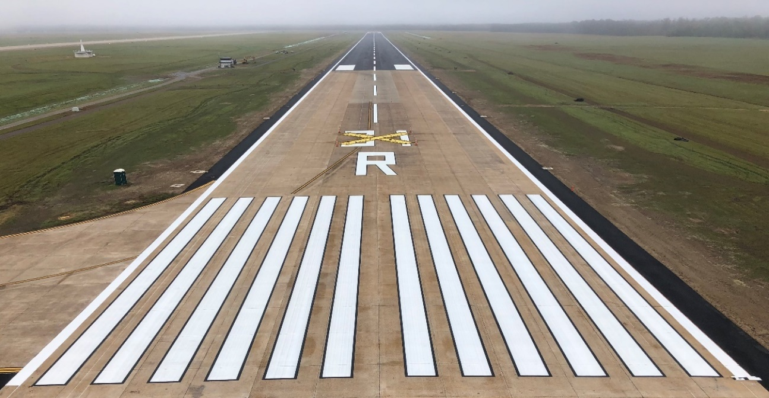
Value Engineering In Design
Aspects of Design that Affect Cost
Notes:
Aspects of Design that effect Cost
Material Requirements
Project Schedule
Contractor Access
Minimizing Risk

Slide 2
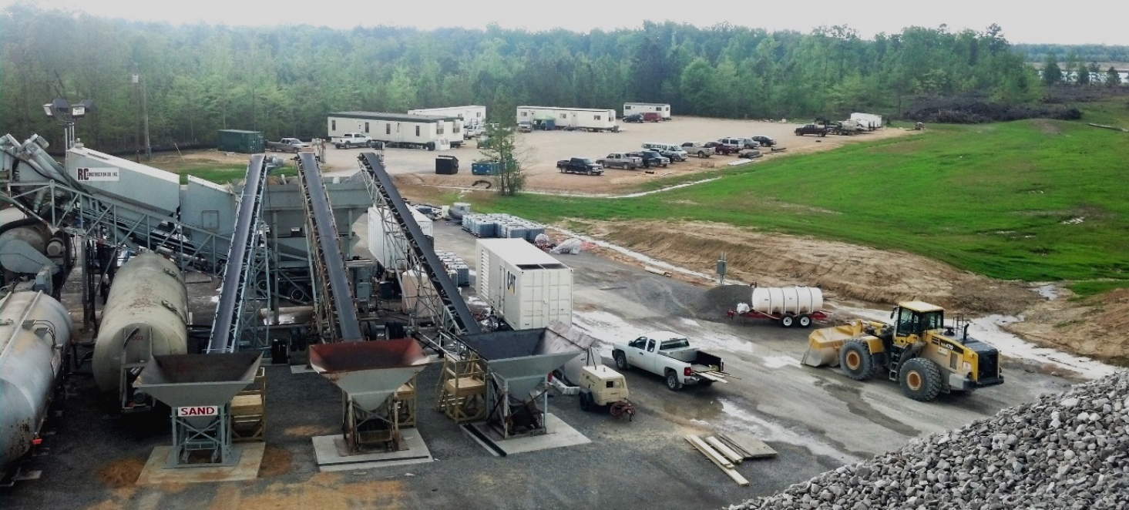
Material Requirements
Concrete and asphalt
Higher quality = increased cost
Sourcing / location
Upfront mix design approval
Amount of material vs. fixed testing costs

Slide 3
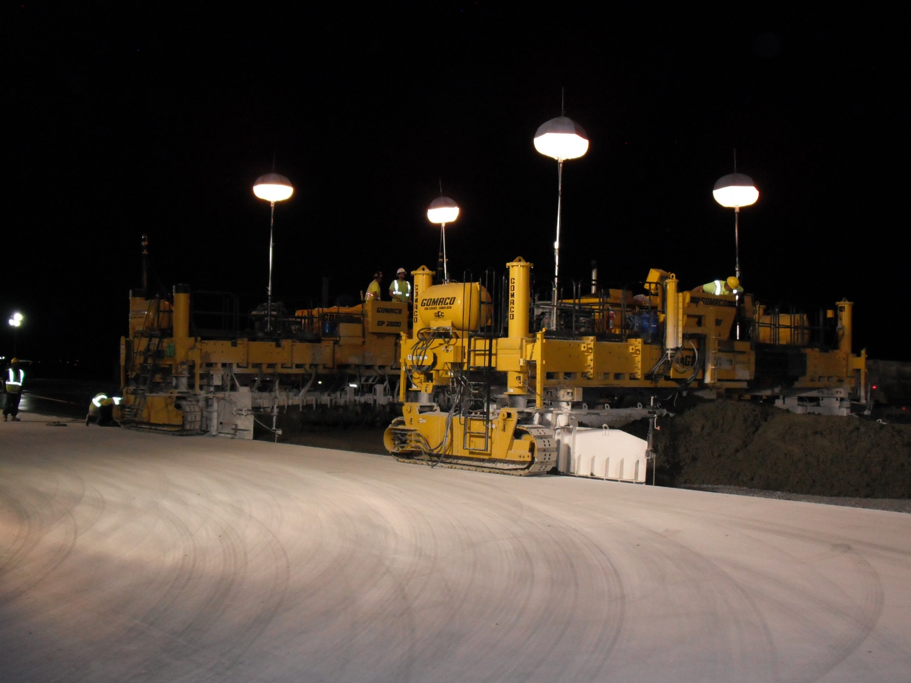
Project Schedule
Accelerated schedule = increased cost
Construction phasing
Onsite / offsite phases
Limits effect on mission
Used to balance schedule / cost

Slide 4
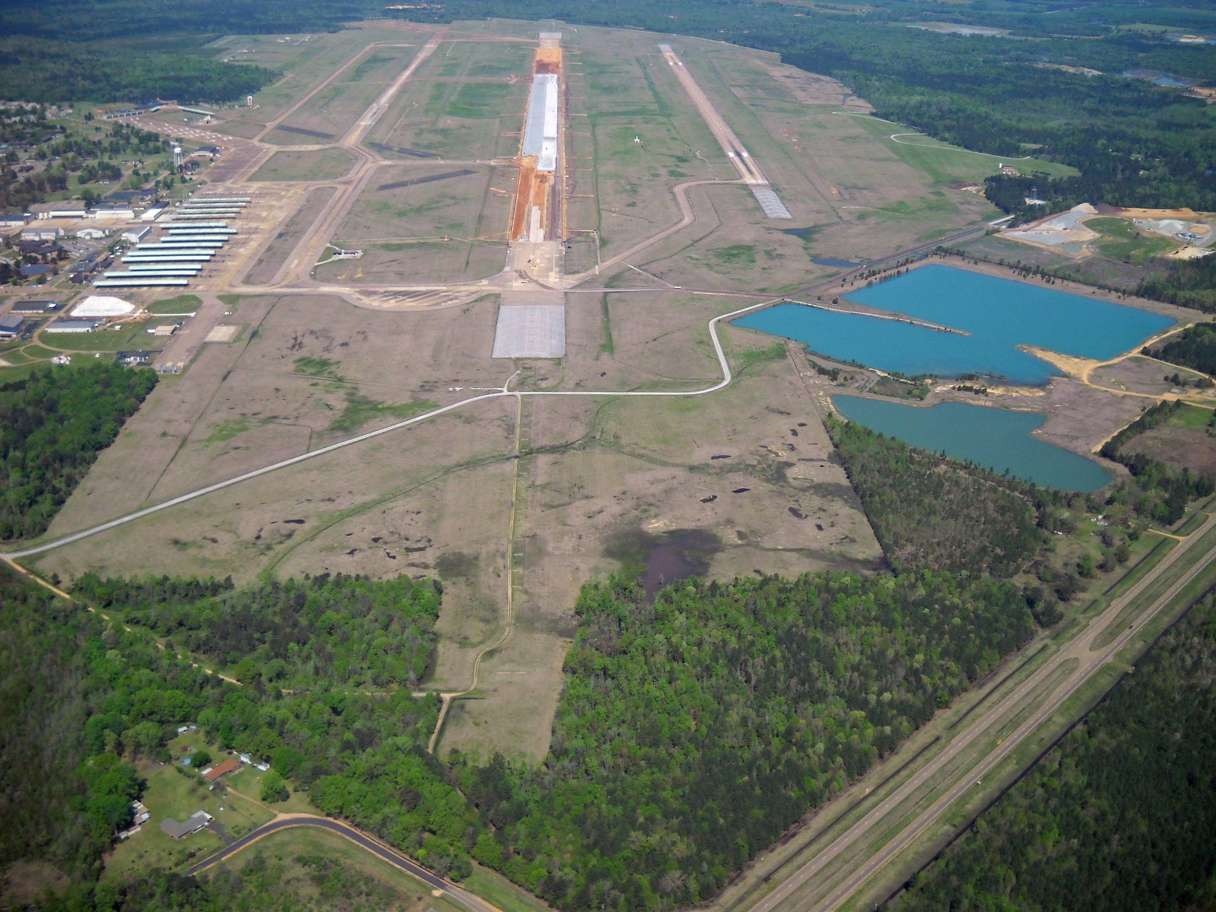
Contractor Access
Limits productivity = increased cost
Time sensitive work items – Paving
Compromise between security / mission operations and construction

Slide 5
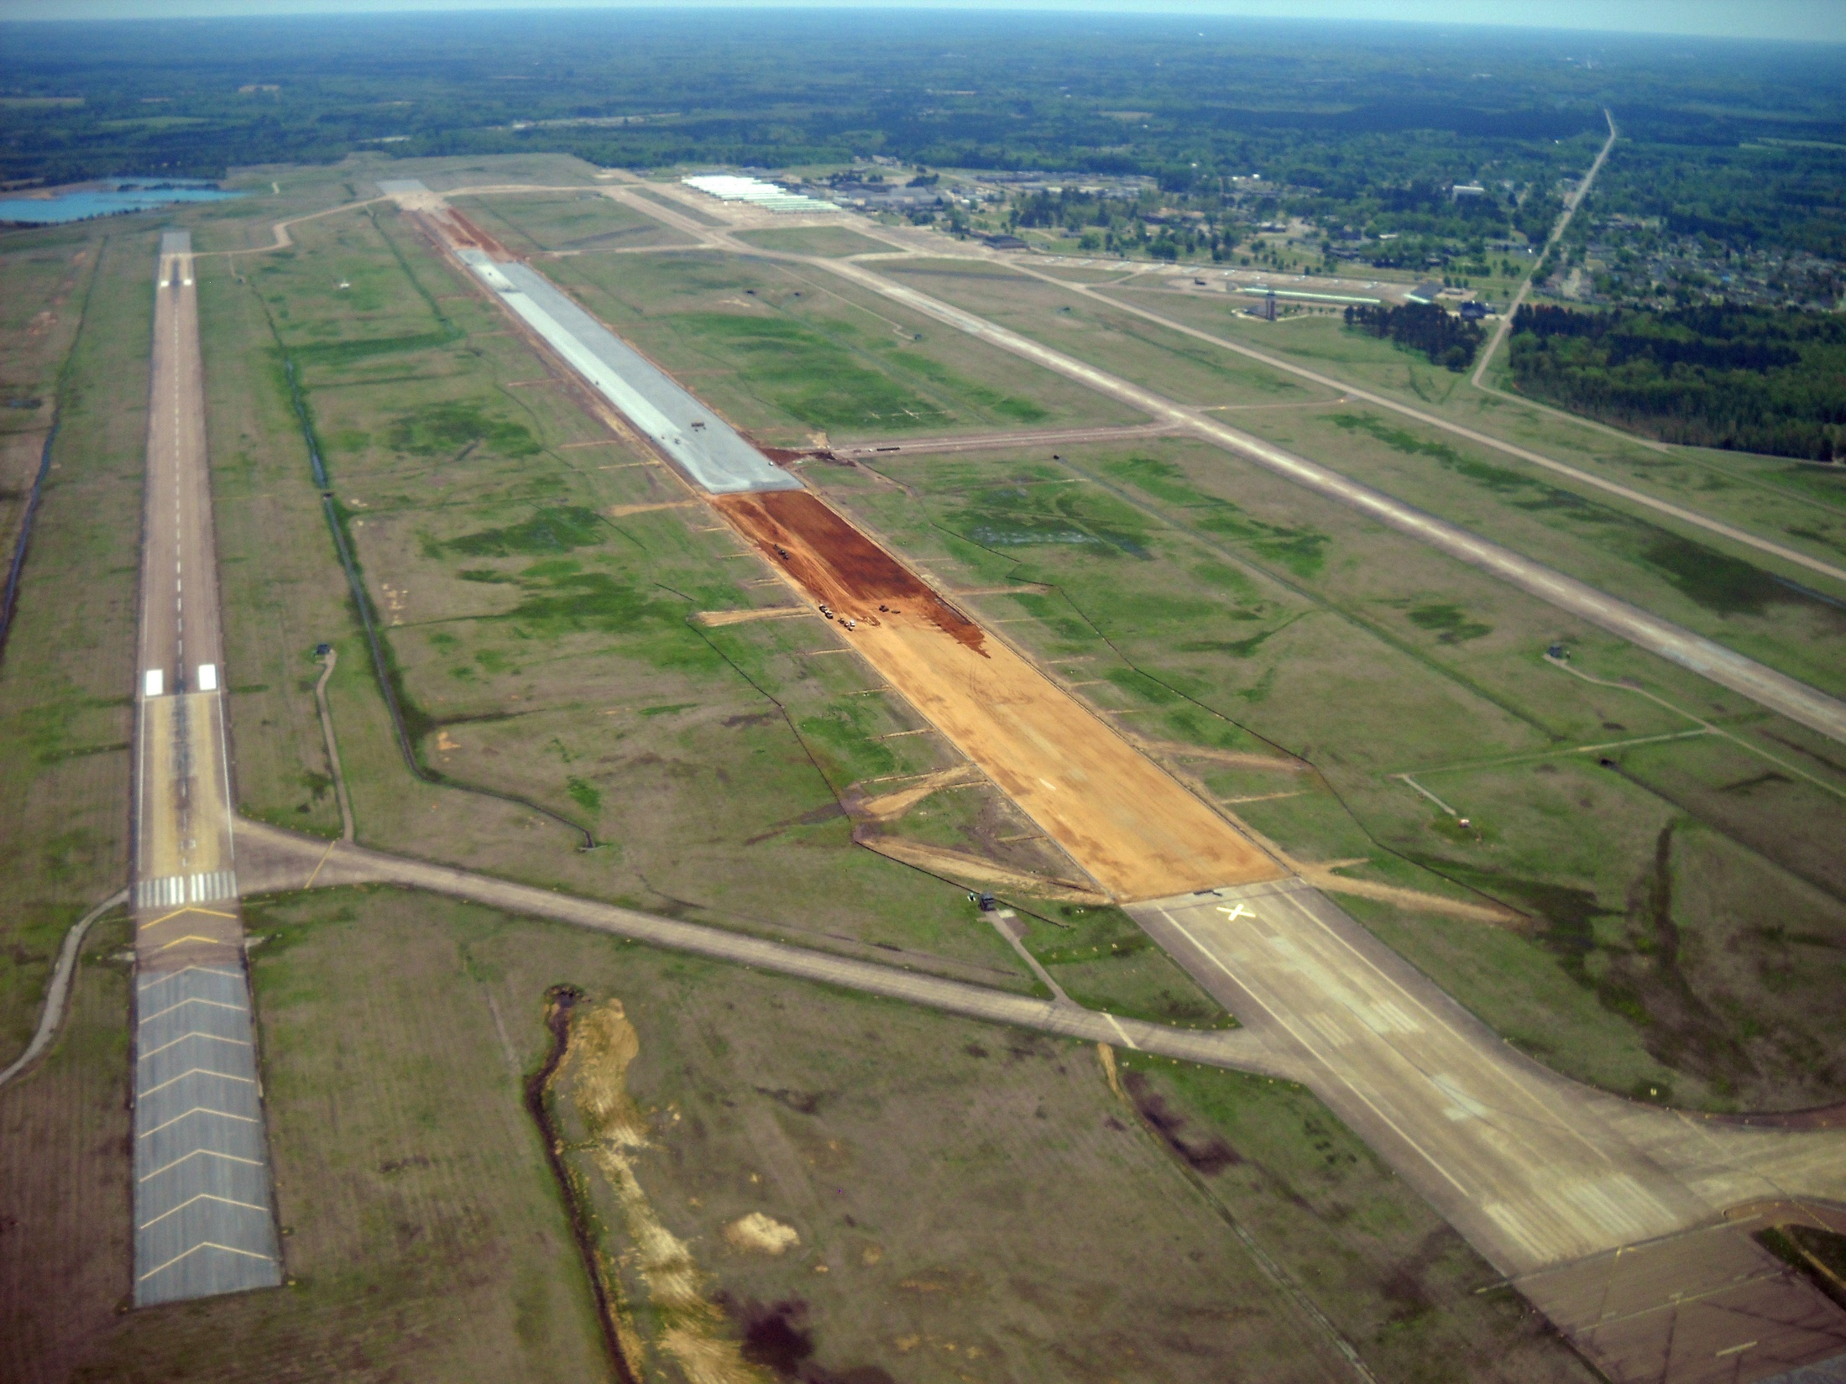
Minimizing Risk
Detailed and clear bidding documents/SOW
Existing conditions + weather
Designs that limit exposure
Protect subgrade and underlying materials
Material submittals approval prior to construction

